Slide 1



Decoding
BIGDATA Analytics & Cloud Computing.
1

Slide 2


Team Members
Patel Yashkumar Subashbhai
200483929
Joshi Jay Vijaybhai
200485155
2

Slide 3

Outline
Problem Statement
Objective
AWS Cloud
AWS Glue , Athena and other Services
Introduction
General Idea about the project
ETL Design
Extract Transform Load Architecture
Background Information
Basic Terminologies
Data Lake
Lake House Architecture
Data Ingestion
Source of Data
Insights & Reports
Results & Conclusions
3

Slide 4

Problem Statement
Our objective is to gain profound insights into YouTube's dynamic ecosystem, pinpoint the factors that drive video and channel success, and deliver actionable recommendations for content creators, marketers, and platform administrators.
4

Slide 5
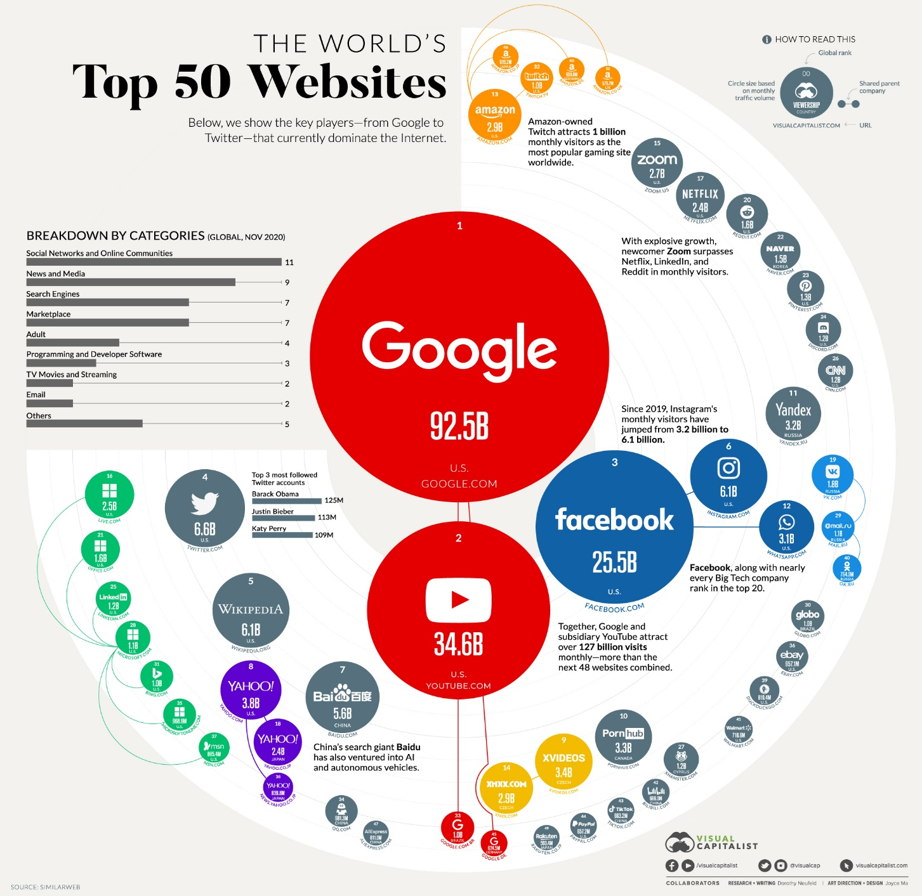
Introduction
Why YouTube ?
-YouTube usage is tremendous.
-Viewers watch 100 million hours of video per day.
-More than 1.9 billion unique users visit YouTube each month.
-Over 300 hours of video are uploaded to YouTube every minute.
Source: visualcapitalist.com
5

Slide 6
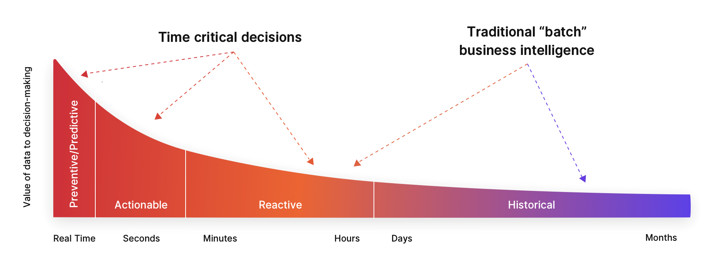
Timely Decisions
Source: Perishable Insights
6

Slide 7

Introduction
- Utilize analysis for growth through strategic video publishing and channel sponsorship.
Goal: Provide insights into YouTube trending videos using AWS services.
Support content creators and digital businesses to maximize potential.
Unlock growth opportunities and audience engagement.
Foster informed and ethical content creation.
Approach: Discover, measure, analyze, and compare key aspects using advanced AWS tools.
7

Slide 8
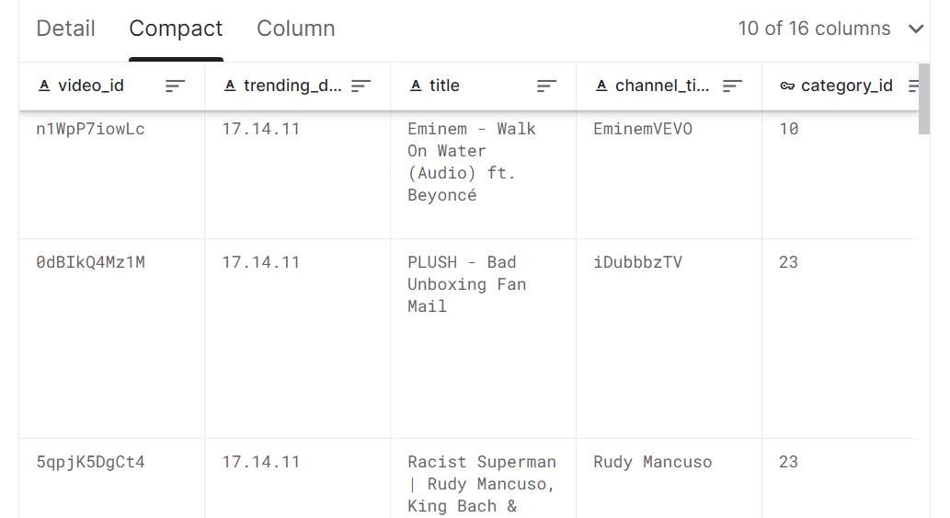

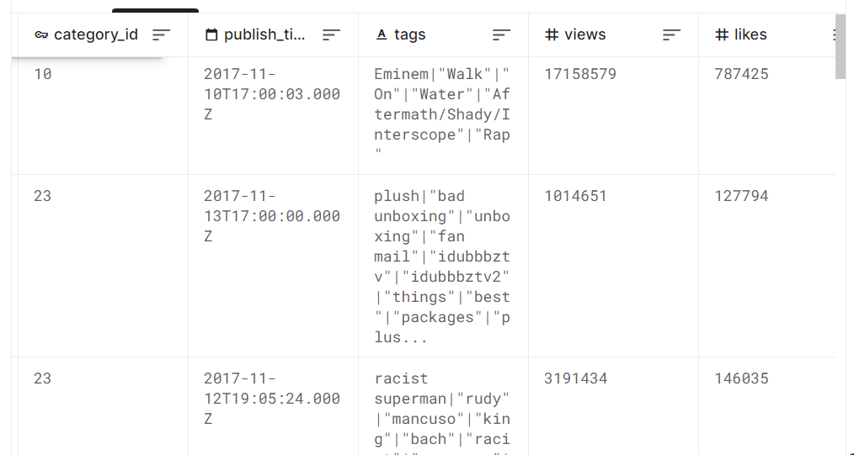
Major Source of Data
Data Snippets
8

Slide 9

Background Information
Concept of Cloud -
- Renting of the computational power or the storage over the internet.
-Offers flexible and scalable resources on demand.
-Stores and manages the data without the need of actual physical hardware.
9

Slide 10

Background Information
Why Cloud is being disruptive ?
-Cloud computing is a cornerstone of digital transformation efforts for businesses, enabling them to modernize their IT infrastructure.
“ A 10-node cluster is running for 10 hours costs the same , as a 100-node cluster running for an hour.”
10

Slide 11







Background Information
Some Common and Popular Cloud Service Providers-
11

Slide 12

Amazon Web Services
What ?
-Offers vast array of services for storage, databases, machine learning and for the computational power.
Why ?
-One of the largest cloud platform.
-Most popular and vast global infrastructure.
-Suitable according to the system requirements.
12

Slide 13

Background Information
Ways to Interact with the AWS environment-
-AWS Console.
-Programmatically:-
-AWS CLI
-SDK
13

Slide 14
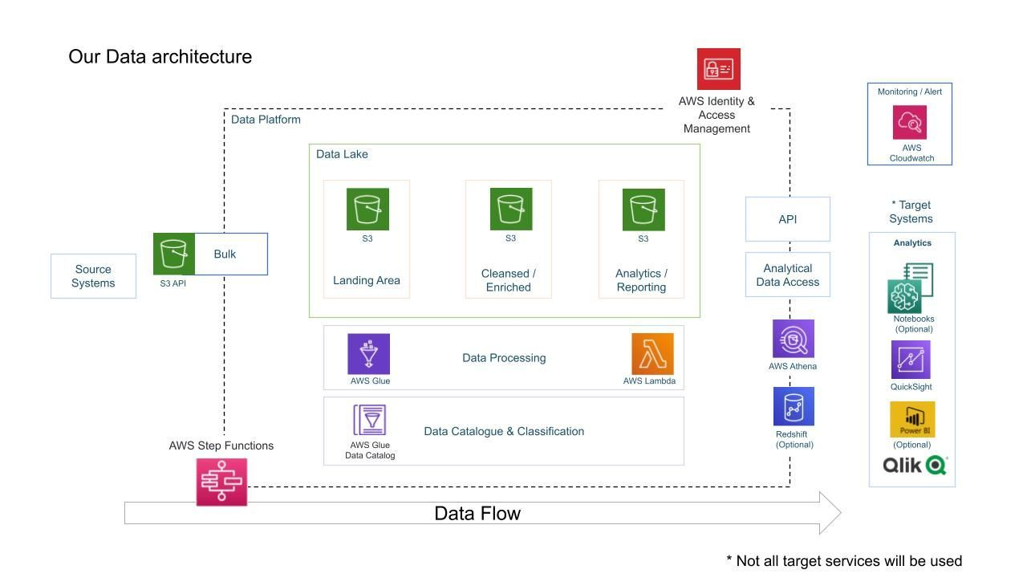
Approach
14

Slide 15
About Dataset
Source: Kaggle dataset containing statistics (CSV files) of frequently viewed YouTube videos.
Time Span: Data spans over multiple months.
Video Releases: 200 popular videos released daily for different regions.
Data Organization: Separate files for each region's data.
Included Information:
Video details: title, channel name, publishing date, tags.
Engagement metrics: views, likes, dislikes, comments.
Description: textual content describing the video.
Category Variation: JSON file contains region-specific category_id.
15

Slide 16
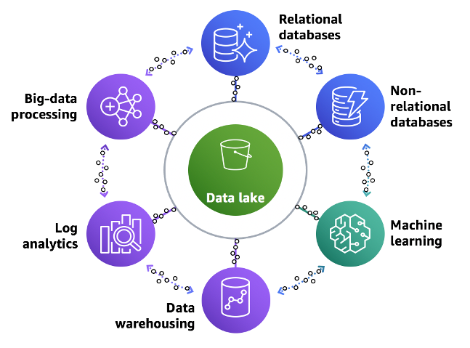
What is DATA Lake House?
SOURCE:- https://aws.amazon.com/blogs/big-data/build-a-lake-house-architecture-on-aws/
16

Slide 17
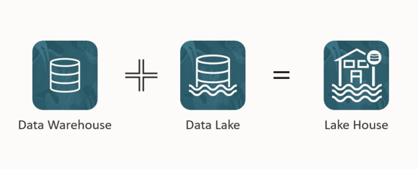
What is Lake House?
Merges the concept of Data Lake and Data Warehouse.
Enables the capability of raw storage , schema enforcement ,indexing and query optimization.
Allows to perform Analytics on huge volume of raw and transformed data.
SOURCE:- AWS Amazon
17

Slide 18
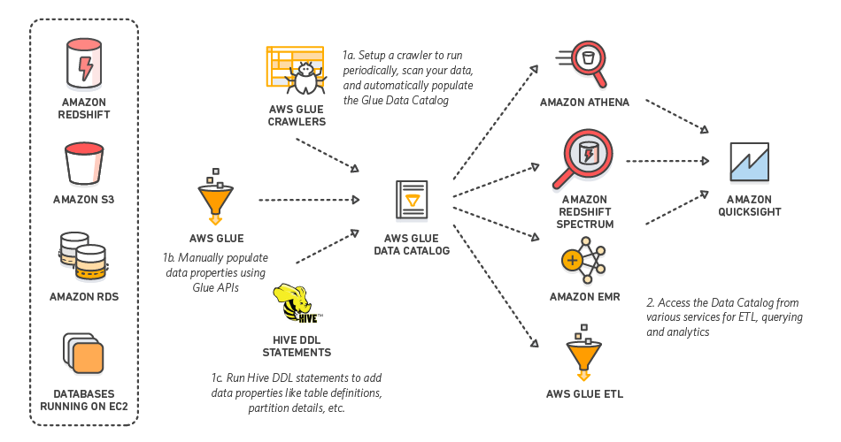
AWS Glue Catalog
Source-https://hevodata.com/learn/working-with-aws-glue-data-catalog/
18

Slide 19

What is AWS Glue Catalog
Metadata Repository.
Central Catalog for storing, managing and discovering meta data information stored in AWS databases.
It is often used as an conjunction with the ETL process in order to automate the data preparation and transformation task.
19

Slide 20

Athena
AWS Athena: Serverless query service for analyzing data in Amazon S3.
Purpose: Query and analyze data using standard SQL.
No Infrastructure: No need to manage servers or infrastructure.
Data Formats: Supports various data formats (CSV, JSON, Parquet, etc.).
Pay-as-You-Go: Pay only for the queries executed.
20

Slide 21
ETL Job and Lambda
ETL: Extract, Transform, Load - Data processing pipeline.
AWS Glue ETL Job: Managed service for ETL tasks.
Data Sources: Extract data from various sources.
Transformation: Clean, filter, and reshape data.
Loading: Load processed data to target destinations.
Scalable: Scales automatically based on data volume.
Source-https://AWS.com
21

Slide 22

ETL Job and Lambda
Integration: Works with various AWS services.
Job Scheduling: Set up automated job execution.
Serverless Computing Service.
It allows to run and manage code without having the actual servers.
Developer just needs to focus on writing code , rest is looked after by AWS( infrastructure, scaling and operational services )
22

Slide 23

AWS Quicksight
Amazon QuickSight: Business Intelligence (BI) tool by Amazon Web Services (AWS).
Purpose: Visualize and analyze data to make informed decisions.
Cloud-based: No software installation, access from anywhere.
Data Sources: Connects to various data sources (AWS, databases, etc.).
Interactive Dashboards: Create interactive and customizable dashboards.
Data Exploration: Discover insights through data exploration.
23

Slide 24
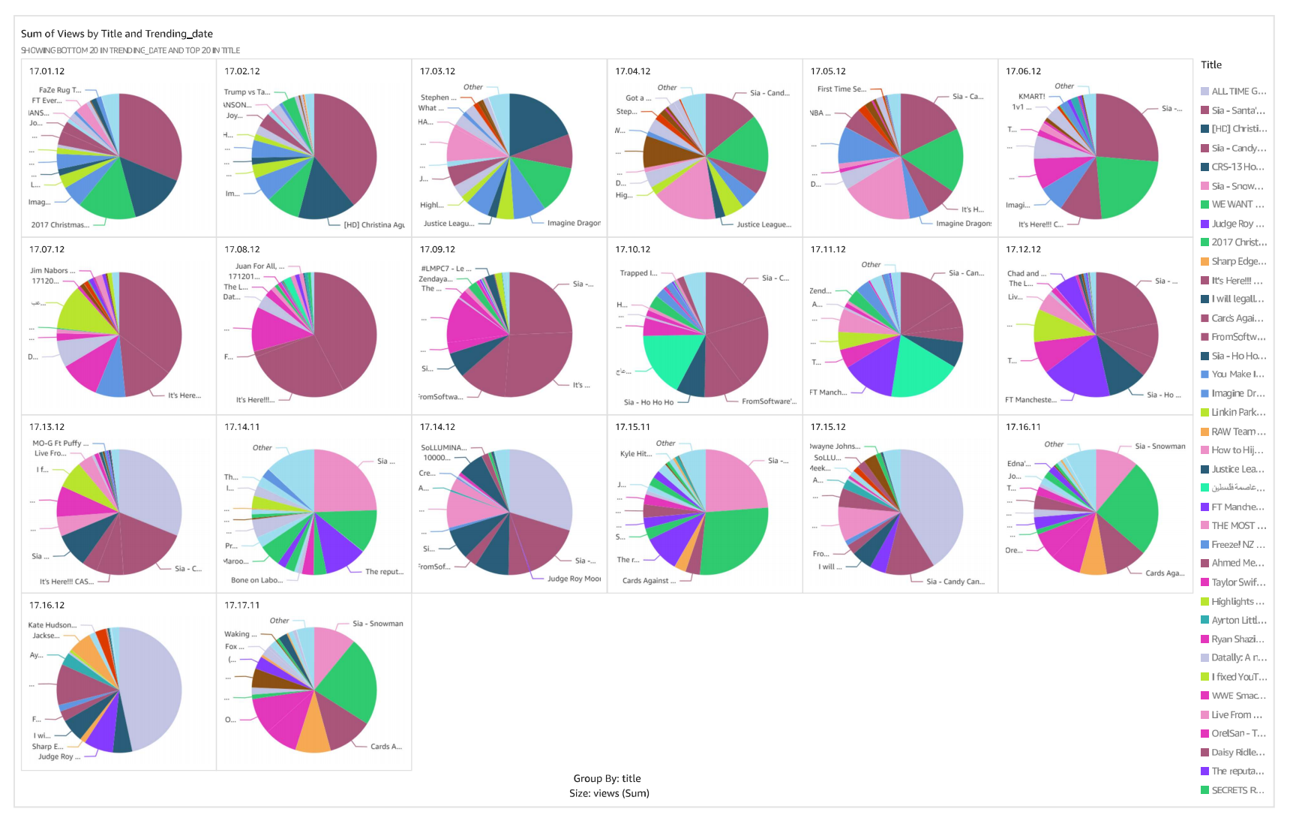
Results(Few Examples)
24

Slide 25
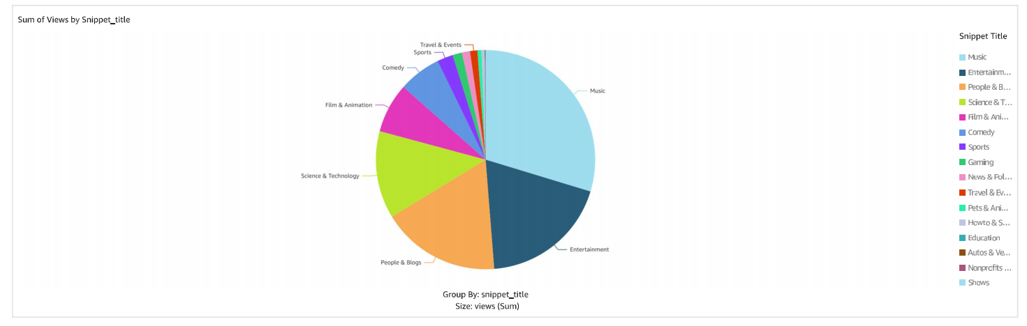
Results(Few Examples)
25

Slide 26
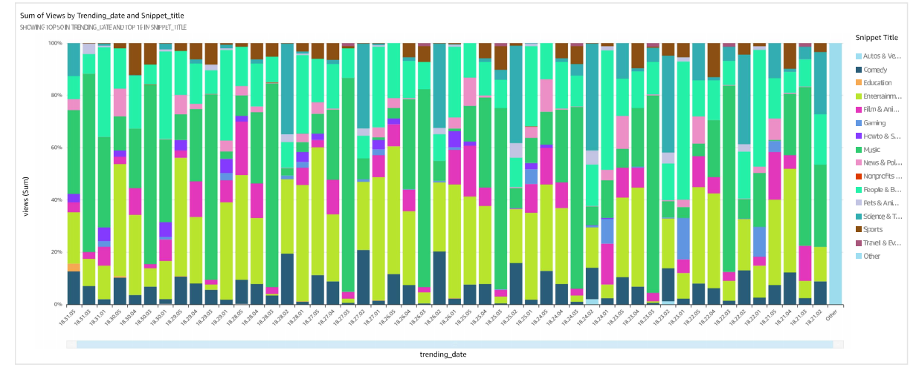
Results(Few Examples)
26

Slide 27
Analysis(Findings)
- Prominent Impact: Music, entertainment, people & blogs.
- Less Liked: Comedy, news & politics, gaming.
- Favorable Categories: Music, entertainment, vlogs.
- Trending Subjects: Utilize popular topics.
- Clever Tags: e.g., "Brunomars," "cardiB."
- Canada: Sports, activism, entertainment.
- US: Fashion, pets, education, travel.
- Germany: Gaming, music, science, blogging, film.
- Neutral Tone: Preferred over extreme sentiment.
27

Slide 28
Analysis(Findings)
- Balanced Perspective: Trending over highly polarized titles.
- Controversy Indicator: Lower ratio suggests contentiousness.
- Comment Correlation: Higher comments linked to lower ratio.
- Traffic Insight: Higher activity in Nov-Dec.
- Holiday Influence: Increased leisure time.
29

Slide 29
Example
Scenario: One company produces both comedy and music content.
Insight: Analysis reveals music videos receive significantly higher views, likes, and user interaction compared to comedy videos.
Action: Company A shifts focus towards producing more music-related content to capitalize on popularity.
Result: Company A's channel experiences increased visibility, engagement, and overall success.
Lesson: Data-driven analysis guides content strategy for optimal results.
Conclusion: YouTube data analysis empowers informed decision-making, ensuring content creators align with audience preferences for enhanced effectiveness and growth.
28

Slide 30
Future Research
Limitations:
Generalizability: Research based on specific dataset and time frame, potential coverage gaps in YouTube content and patterns over time.
Language Compatibility: Diversity of languages poses challenges in making content comprehensible to computers.
Encoding Complexity: Handling different languages' content requires proper encoding for computer understanding.
Possible Extensions:
Competitor Comparison: Extend study to analyze trends on other video platforms like Vimeo, TikTok, for a broader content popularity perspective.
Encoding Optimization: Further research into efficient encoding techniques for better multilingual text to machine-level code conversion(Can use UTF).
30

Slide 31
Conclusion
Discover hidden patterns, trends, and correlations.
Factors: viewership, user interaction, metadata, content classification.
Target: Administrators, marketers, creators.
Systematic approach: data intake, ETL, data lake, scalability, cloud, visualization.
Cloud computing: manage extensive YouTube data efficiently.
Limitations: unique dataset, timeframe.
Language bias: English-centric content representation.
Extensions: compare other platforms, explore encoding methods.
31

Slide 32
Appendices
Url:-https://us-east-1.quicksight.aws.amazon.com/sn/auth/signin?qs- signin-user-auth=false&redirect_uri=https%3A%2F%2Fus-east- 1.quicksight.aws.amazon.com%2Fsn%2Fstart%3Fqs-signin-user- auth%3Dfalse%26state%3DhashArgs%2523%26isauthcode%3Dtrue
AWS Credentials
Username:-Jay-project
Password:-CS714_project
Account name:-jayjosh
32

Slide 33
References
www.visualcapitalist.com
https://www.serverless.com/aws-lambda
www.Kaggle.com
https://www.databricks.com/glossary/data-lakehouse
https://aws.amazon.com/athena/
https://aws.amazon.com/quicksight/
https://aws.amazon.com/glue/
www.ibm.com
https://aws.amazon.com/lambda/
https://docs.aws.amazon.com/
33

Slide 34
THANK YOU

